Slide 1
Delivering WPC and Advancing Health Equity
September 30, 2022

Slide 2
Panelists
MMX: do you have headshots we can use here?
Lakshmi Dhanvanthari, MD,
Chief Medical Officer,
Health Plan of San Joaquin
Jolie Onodera,
Senior Legislative Representative for Health and Behavioral Health,
California State Association of Counties
Sandra Hernandez,
President & Chief Executive Officer,
California Health Care Foundation
Jonah Frohlich,
Senior Managing Director, Manatt Health (moderator)
Demetria Malloy, MD,
Regional Vice President Medical Director,
Elevance Health

Slide 3
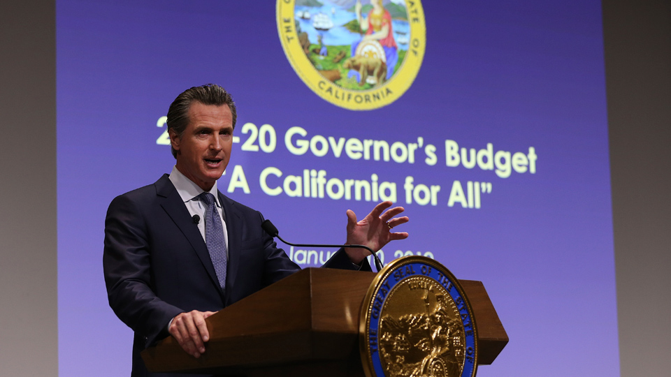
Three years ago, Governor Newsom laid out a vision for a California for All
Governor Newsom set a path to simultaneously create effective, culturally competent, and efficient safety-net programs that address the whole-person needs of vulnerable Californians while also creating policies and practices that support the creation of inclusive communities where all Californians from diverse backgrounds and with diverse resources and opportunities can be healthy and thrive.

Slide 4
CalHHS Guiding Principles and Strategic Priorities
Focus on Equity by creating programs that address persistent and systemic inequities.
Actively Listen to individuals and communities to better understand their conditions and formulate better policies, programs and services that meet their needs.
Use Data to Drive Action to help advance social and economic mobility, and improve the health and well-being of children, families and individuals.
See the Whole Person by focusing on the needs of the people we serve, not on the siloed structures of government and its programs.
Put the Person Back in Person-Centered with programs that are informed and structured to meet the diverse and unique needs of each community and person.
Cultivate a Culture of Innovation to catalyze our improvement efforts and solve intractable problems.
Deliver on Outcomes by continuously evaluating and adapting our programs to better address our clients’ unmet needs while furthering our goal of delivering positive outcomes.

Slide 5
The California Data Exchange Framework (DxF)
In 2021 Governor Newsom signed AB 133, putting California on a path to building a single data sharing agreement to govern health information exchange
The law mandates that a broad spectrum of health care organizations execute the Framework’s Data Sharing Agreement (DSA) by January 31, 2023, and exchange health information with other mandated organizations by January 31, 2024.
The Framework identifies infrastructure and capacity gaps, and opportunities that could be undertaken to address them including:*
Developing a technical assistance and HIE onboarding program
Establishing a data exchange intermediary qualification process
Expanding federal event notification requirements
Upgrading public health and county health IT infrastructure
Improving standardized demographic, SDOH and SOGI data collection
Improving individual data access
Establishing provider directory and digital identity capabilities
*https://www.chhs.ca.gov/wp-content/uploads/2022/07/6_CalHHS_DxF_Gaps-and-Opportunities_Final_v1_07-01-2022.pdf

Slide 6
Medi-Cal is a complex system to navigate, and many enrollees have needs outside health care
Managed Care Plans
Mental Health Plans (counties)
Substance use services (counties)
Specialty mental health care
State Fee-for-Service system
Addiction treatment*
Social service providers/agencies
Mild to moderate mental health care
Medicare
Prescription drugs
Dental care
Food Insecurity: CalFresh
Help at home: In Home Supportive Services
Housing Insecurity: Homeless Service Providers
Physical health care
California Children’s Services*
Long Term Care in nursing homes*
Home and Community Based Services waiver programs
Justice system involvement: Jail/Parole/Prison
* Varies by county
Source: California Health Care Foundation

Slide 7
Department of Health Care Services (DHCS): CalAIM
Two years ago, DHCS launched “CalAIM” a long-term commitment to transform and strengthen Medi-Cal
CalAIM represents a significant investment and sustained commitment to integrate Medi-Cal more seamlessly with social services to deliver whole person care and improve outcomes for millions of Californians covered by Medi-Cal, especially those with the most complex needs.
Population Health Management requirements for managed care plans (MCPs) to implement whole-system, person-centered strategies that includes enrollee assessments, car​e management and care transition services.
Enhanced Care Management benefits to deliver person-centered care management to the highest-need Medi-Cal enrollees through in-person engagement where enrollees live, seek care, and choose to access services.
Community Supports services such as housing supports and medically tailored meals, that play a fundamental role in meeting enrollees’ needs for heath and health-related services that address social drivers of health.
PATH capacity and infrastructure funding for community-based organizations (CBOs), public hospitals, county agencies, tribes, and others to successfully participate in the Medi-Cal delivery system.
Incentives and Payment Reform to reimburse physical and behavioral health providers based on service outcomes rather than service volume.
www.dhcs.ca.gov/calaim

Slide 8
Discussion Questions [not for presentation]
How do we account for the fact that many of the key partners in CalAIM -- like behavioral health providers, social service providers, and CBOs -- don't have the same level of data infrastructure that we have with physical health care?
What major obstacles remain that prevent more widespread data exchange to meet CalAIM goals, and what are plans and counties doing to overcome them?
CHCF has been doing a lot of work around older adults and CalAIM, given the ways in which home and community-based services and long-term care are evolving under the program, e.g.,:
(2021) Carving in long-term care and coverage of transplants to become the responsibility of all Medi-Cal managed care plan
(2023)
institutional Long-Term Care (LTC) will be carved-in to Medi-Cal managed care in all counties
mandatory enrollment of full dual eligible beneficiaries into MCPs for Medi-Cal benefits
How should we be thinking about data and data exchange in this context?
What advice would you give to Governor Newsom, Secretary Ghaly and Jacey Cooper to help expedite data exchange and support CalAIM implementation?

